Slide 2
Chapter 5, LO 1, key term
Discuss medication dosage conversion
Define the following term:
convert
in medication administration, to change the amount of medication from one measuring system to another.

Slide 3
LO1, content 1
Discuss medication dosage conversion
Doctors, pharmacists, and nurses are authorized to convert dosages. MAs are not. MAs should
Recognize standard units of measurement for different measuring systems
Check dosages carefully before administering a medication and report any suspected errors

Slide 4
LO2, key terms
Explain the most common measurement systems for medication dosage
Define the following terms:
metric system
a system of measurement based on the meter, the kilogram, and the liter; preferred for scientific and healthcare use.
household measurements
a system of measurements that uses the yard, the pound, and the fluid ounce; should not be used to measure medications.
apothecaries’ system
one of the oldest systems of measurements; was once used to measure medications, but now rarely used.

Slide 5
LO2, content 1
Explain the most common measurement systems for medication dosage
Remember the following points about measurement systems:
Metric and household systems are most common
The apothecaries’ system is now rarely used
The metric system is the standard system of measurement for healthcare
Metric system is based on units of 10 and allows for accurate calculations
OTC medications may list dosages in both metric and household measurements

Slide 6
LO2, content 2
Key Material 5-1: Metric Units and Equivalents
Weight (mass, or the amount of matter in something) is measured using these metric units:
1000 micrograms (mcg) = 1 milligram (mg)
1000 mg = 1 gram (g)
1000 g = 1 kilogram (kg)
Length is measured using these metric units:
10 millimeters (mm) = 1 centimeter (cm)
100 cm = 1 meter (m)
1000 m = 1 kilometer (km)
Volume is measured using these metric units:
1000 microliter = 1 milliliter (mL)
1000 mL = 1 liter (L)

Slide 7
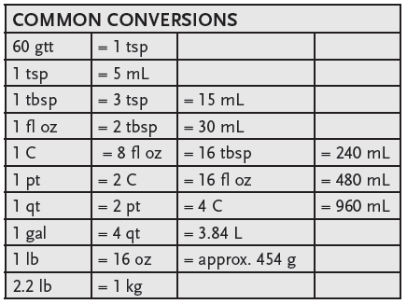
LO2, content 3
Key Material 5-2: Common Conversions

Slide 8
LO2, content 4
Explain the most common measurement systems for medication dosage
Critical Thinking: Conversation Starter
Are you comfortable using the metric system?
Why or why not?
Are there types of metric measurements you are familiar with and others you are not as familiar with (for example you might be familiar with metric measurements for volume, but not for weight)?

Slide 9
LO3, key terms
Explain dosage range
Define the following terms:
clinical trial
testing performed on patients during the development of a new medication.
dosage range
the maximum and minimum doses to achieve the desired effects of a drug, determined during clinical trials.
toxicity
in medication administration, a poisoning effect caused by too high a dose or from an adverse reaction.
therapeutic dose
a dose of a medication that has the desired effect on the patient.

Slide 10
LO3, content 1
Explain dosage range
Remember this information regarding dosage range:
A therapeutic dose is a dose that has the desired effect on the patient
Too high a dose can cause toxicity
Too low a dose will prevent the medication from working properly
Some drugs work in a very narrow range; in these cases tests may be performed to ensure the dose is correct
Many residents take several different medications with narrow therapeutic ranges
MAs’ observations and reports help ensure that residents are receiving the proper dose and that their medications are providing the desired effects

